Slide 1
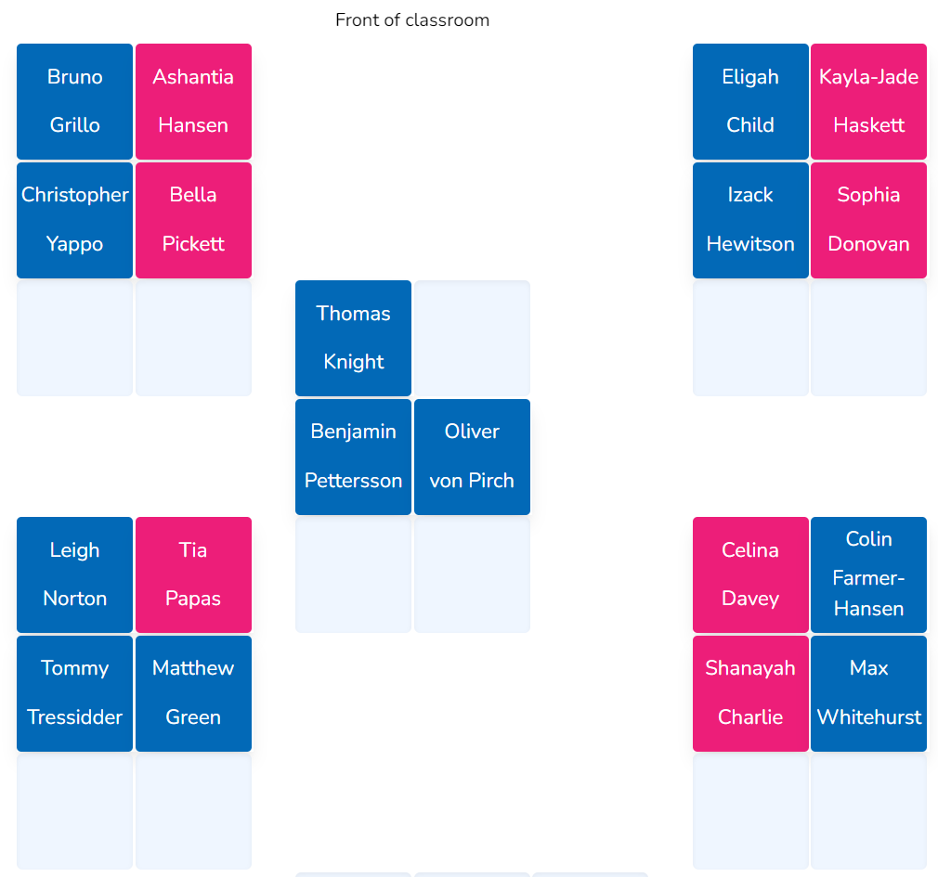
Seating Plan

Slide 2
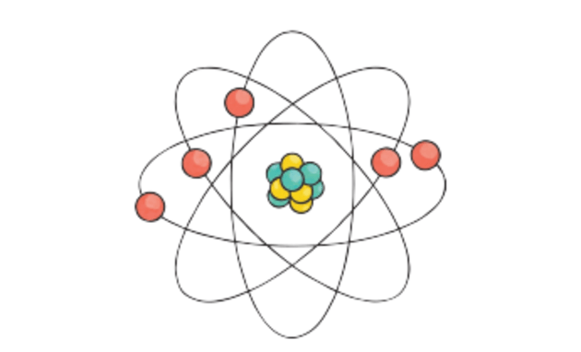
Repeat the opposite word/phrase.
ATOM
THE SMALLEST PARTICLE OF A CHEMICAL ELEMENT THAT CAN EXIST.

Slide 3
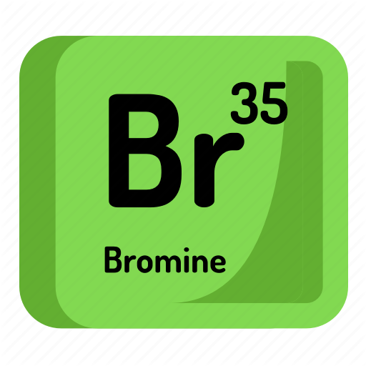
Repeat the opposite word/phrase.
ELEMENT
A SUBSTANCE THAT CONTAINS ONLY ONE TYPE OF ATOM

Slide 4
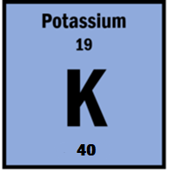
Repeat the opposite word/phrase.
ATOMIC NUMBER
THE NUMBER OF PROTONS IN AN ATOM

Slide 5
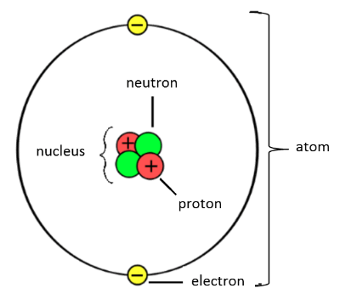
The structure of an atom
An atom is made up of protons, neutrons and electrons.
Protons and neutrons make up the nucleus which is at the centre of the atom.
Electrons are found in shells (or orbitals)around the outside of the nucleus.

Slide 6
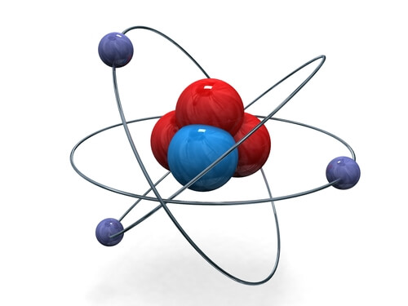
The structure of an atom
Atoms are made up of three subatomic particles: protons, neutrons and electrons.
The nucleus (centre) of an atom is made up of protons and neutrons.
The electrons orbit around the outside of the nucleus in shells.

Slide 7
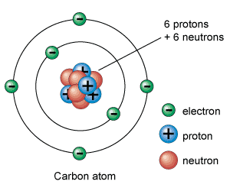
Charges!
A proton has a positive charge
A neutron has no charge
An electron has a negative charge

Slide 8
Charges!
A proton has a positive charge
A neutron has no charge
An electron has a negative charge

Slide 9
We are learning about isotopes and stability
TRACK WITH ME
READ WITH ME
Students will be able to:
Define the term isotope.
Explain why some isotopes are unstable.
Determine the number of protons, neutrons and electrons in an isotope.

Slide 10
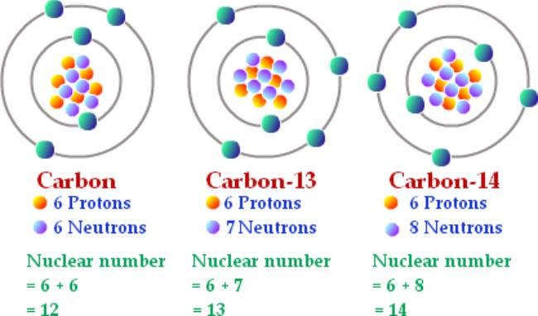
Isotopes
Isotopes of an atom have the same number of protons but a different number of neutrons.
Therefore, isotopes of an atom have the same atomic number but a different mass number.
The isotope is still neutrally charged as there are still and equal amount of protons and electrons in the atom.

Slide 11


Slide 12
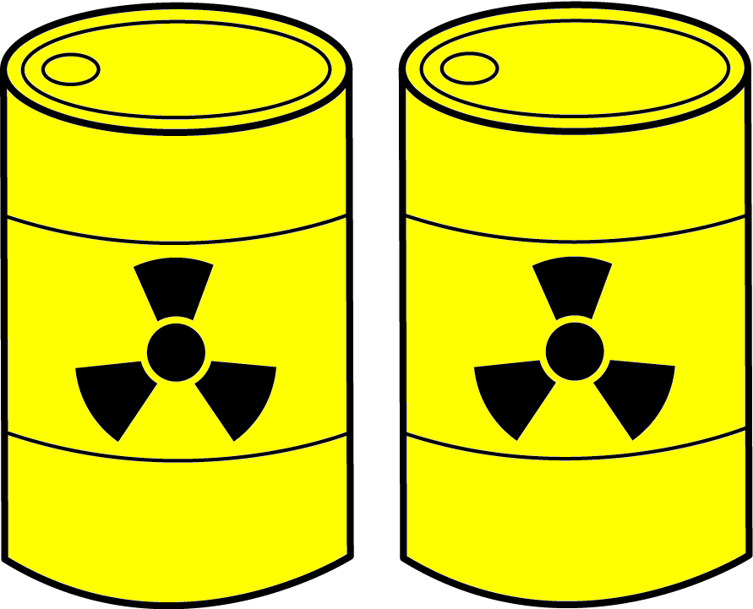
Radioactive Isotopes
Most isotopes are stable. Stable isotopes have a “happy” balance of protons and neutrons.
Some isotopes are not stable. An unstable isotope is called a radioactive isotope or radioisotope because it emits radiation.
Radiation is the release of energy in the form of waves or subatomic particles.
Radiation is dangerous because it can harm the cells of living things.

Slide 13
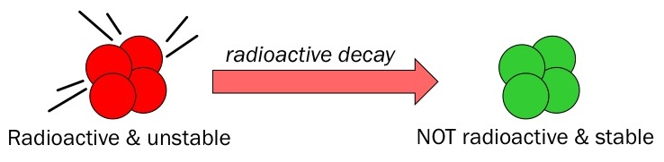
Radioactive Decay
A radioactive isotope releases energy in order to become stable. This process is called radioactive decay.
During radioactive decay, the atom emits radiation. Radiation can be high-energy waves and/or subatomic particles.
As the atom undergoes radioactive decay, it becomes stable. As a stable isotope, the atom no longer emits radiation.

Slide 14
Unstable Atoms
An unstable atom emits excess energy from its nucleus to become more stable.
The energy and particles released are called nuclear radiation.
+
+
Unstable Nucleus
Stable Nucleus
Particles
Energy
Radiation

Slide 15
We are learning about isotopes and stability
TRACK WITH ME
READ WITH ME
Students will be able to:
Define the term isotope.
Explain why some isotopes are unstable.
Determine the number of protons, neutrons and electrons in an isotope.

